Slide 1
CS 2212
Introduction to Software Engineering
Chapter 14 Pattern Based Design

Slide 2
Copyright Notice This Presentation and Its Associated Video Contain Copyright Material. This Presentation and Its Associated Video Are Provided for Teaching Purposes of CS2212 and Should Not Be Posted In Any External Site, Or Shared with. This Presentation and Its Associated Video Are Provided For Instructional Personal Use Only, and Only For The Purposes of the CS2212 Course.

Slide 3
Part 34
Call and Return Architectural Style
When I asked Sam Shillace, who ran Gmail and Google Apps for four years, about the costliest mistake he's seen engineers make, his response was, "Trying to rewrite stuff from scratch -- that's the cardinal sin.”
― Edmond Lau, “The Effective Engineer: How to Leverage Your Efforts In Software Engineering to Make a Disproportionate and Meaningful Impact”
Notes:
This lesson introduces the basic steps in a software engineering project at a high level.
In practice, steps often overlap.

Slide 4
Learning Objectives in this Part
To understand the Call and Return Architectural Style

Slide 5
Overview
Architectural styles and patterns
Data flow
Call-and-return
Main program/subroutines
Information hiding
Data Abstraction, Object Oriented
Interacting processes
Data-oriented repository
Hierarchical
Other
Heterogeneous architectures

Slide 6
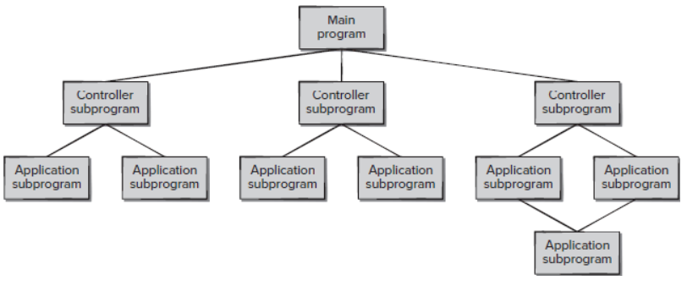
Main Program + Subroutine Architecture
Classic style since 60s - pre-OO.
Hierarchical decomposition into subroutines (Components) each solving a well defined task/function.
Data passed around as parameters.
Main driver provides a control loop for sequencing through subroutines.

Slide 7
Data Abstraction / Object Oriented
Widely used architectural style
Components:
Objects or abstract data types
Connections:
Messages or function/procedure invocations
Key aspects:
Object preserves integrity of representation - no direct access
Representation is hidden from objects
Variations:
Objects as concurrent tasks
Multiple interfaces for objects for objects (Java !)
Note that Data Abstraction is different from Object-Oriented - no inheritance.

Slide 8
Object-Oriented Strengths/Weaknesses
Strengths:
Change implementation without affecting clients (assuming interface doesn’t change)
Can break problems into interacting agents (distributed across multiple machine / networks).
Weaknesses:
To interact objects must know each other’s identity (in contrast to Pipe and Filter).
When identity changes, objects that explicitly invoke it must change (Java interfaces help though).
Side effect problems: if A uses B and C uses B, then C effects on B can be unexpected to A (and vice-versa).
Complex dynamic interactions – distributed functionality.

Slide 9
Part 35
Interacting Processes Architectural Style
It's OK to figure out murder mysteries, but you shouldn't need to figure out code. You should be able to read it.
― Steve McConnell.
Notes:
This lesson introduces the basic steps in a software engineering project at a high level.
In practice, steps often overlap.

Slide 10
Learning Objectives in this Part
To understand the Interacting Processes Architectural Style with emphasis on Event Systems

Slide 11
Overview
Architectural styles and patterns
Data flow
Call-and-return
Interacting processes
Distributed Objects
Event Systems
Data-oriented repository
Data-sharing
Hierarchical
Other
Heterogeneous architectures

Slide 12
Comm. Processes - Distributed Objects: RMI
Communication
modules
Proxy for A
A’s client stubs
A’s skeleton
A server stubs
dispatcher
X
A
ROID
modules
X is a “fake” object in the client side and is used in place of a “real” object
A in the server side. Communication and correspondence is achieved by the
“intermediate stud and skeleton objects offered by the RMI framework.

Slide 13
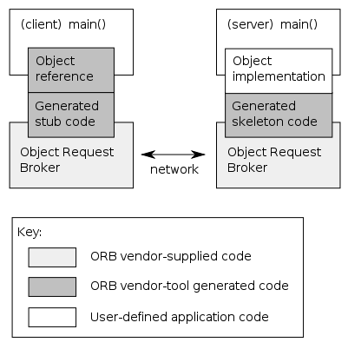
Comm. Processes - Distributed Objects: CORBA

Slide 14
Event-Based, Implicit Invocation
This architecture is characterised by the style of communication between components:
Rather than invoking a procedure directly or sending a message a component announces, or broadcasts, one or more events.
Basically, components communicate using a generalised Observer Design Pattern style of communication.
BUT this is a different architecture from Object-Oriented we have see in the Call-and-return family of architectures
Communications are broadcast-based and components are not necessarily objects.

Slide 15
Implicit Invocation Example
Components register interest in an event by associating a procedure with the event.
When the event is announced the system implicitly invokes all procedures that have been registered for the event.
Common style for integrating tools in a shared environment, e.g.,
Tools communicate by broadcasting or multicasting interesting events
Other tools register patterns that indicate which events should be routed to them and which method/procedure should be invoked when an event matches that pattern.
Pattern matcher responsible for invoking appropriate methods when each event is announced.

Slide 16
Implicit Invocation Example
Examples:
Editor announces it has finished editing a module, compiler registers for such announcements and automatically re-compiles module.
Debugger announces it has reached a breakpoint, editor registers interest in such announcements and automatically scrolls to relevant source line.

Slide 17
Implicit Invocation
Components
Modules whose interfaces provide a collection of procedures/methods and a set of events that it may announce
Connectors
Bindings between event announcements and procedure/method calls
Traditional procedure/method calls (to bypass implicit invocation)

Slide 18
Implicit Invocation
Invariants
Announcers of events do not know which components will be affected by those events
Components cannot make assumptions about ordering of processing, or what processing will occur as a result of their events
Common Examples (Shaw and Garlan textbook)
Programming environment tool integration
User interfaces - Model-View-Controller
Syntax-directed editors to support incremental semantic checking

Slide 19
Implicit Invocation
Strengths
Strong support for reuse - plug in new components by registering it for events
Maintenance - add and replace components with minimum affect on other components in the system.

Slide 20
Implicit Invocation
Weaknesses
Loss of control
when a component announces an event, it has no idea what components will respond to it
cannot rely on order that these components will be invoked
cannot tell when they are finished
Ensuring correctness is difficult because it depends on context in which invoked. Unpredictable interactions.
Sharing data - see the Observer Design Pattern
Hence explicit invocation is usually provided as well as implicit invocation. In practice architectural styles are combined.

Slide 21
Model-View-Controller
A decomposition of an interactive system into three components:
A model containing the core functionality and data,
One or more views displaying information to the user, and
One or more controllers that handle user input.
A change-propagation mechanism (i.e., observer) ensures consistency between user interface and model, e.g.,
If the user changes the model through the controller of one view, the other views will be updated automatically
Sometimes the need for the controller to operate in the context of a given view may mandate combining the view and the controller into one component
The division into the MVC components improves maintainability
Variations of MVC include Model-View-Adapter and Model-View-Presenter (see Your Turn slide)

Slide 22
Model-View-Controller
view1
controller1
view2
controller2
view3
model

Slide 23
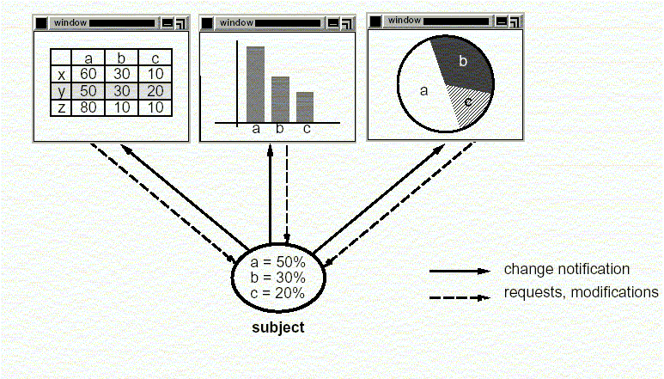
Model-View-Controller

Slide 24
Model/View/Controller (MVC)
In this architecture under the style of implicit invocation there are three different typed of components:
Model Components: Denote and implement the domain application data
Viewer Components: Denote and implement the different ways data are presented to the user or to other systems
Controller Components: Implement software logic that alter the data in the model (i.e. in the Model Components)
Controller
initiator
*
1
repository
Model
1
notifier
View
subscriber
*

Slide 25
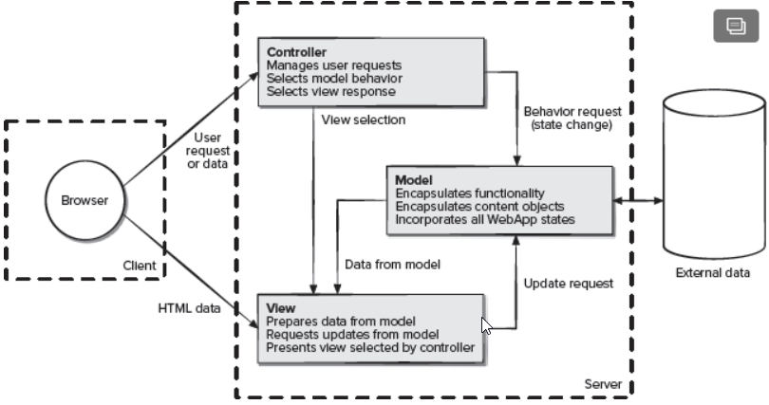
Model/View/Controller (MVC)

Slide 26
Communication Diagram MVC
2.User types new filename
:Controller
3. Request name change in model
1. Views subscribe to event
:Model
5. Updated views
:InfoView
4. Notify subscribers
:FolderView

Slide 27
Your Turn
Discuss the difference between Main Program and Subroutine and Object Oriented. Why do we need Object Oriented? After all one can claim that one method calls another even in Object Oriented architectures.
Provide two examples of systems where the MVC architecture is most suitable for use. Explain your answer and briefly elaborate how MVC will be used.
Check-out the content of the following sites:
https://en.wikipedia.org/wiki/Model-view-controller
https://en.wikipedia.org/wiki/Model-view-adapter
https://en.wikipedia.org/wiki/Model-view-presenter
https://aws.amazon.com/event-driven-architecture/

